Slide 1

Troubleshooting Switched Networks
Medium-Sized Switched Network Construction
© 2007 Cisco Systems, Inc. All rights reserved.
ICND2 v1.0—2-1
The PDF files and any printed representation for this material are the property of Cisco Systems, Inc., for the sole use by Cisco employees for personal study. The files or printed representations may not be used in commercial training, and may not be distributed for purposes other than individual self-study.

Slide 2
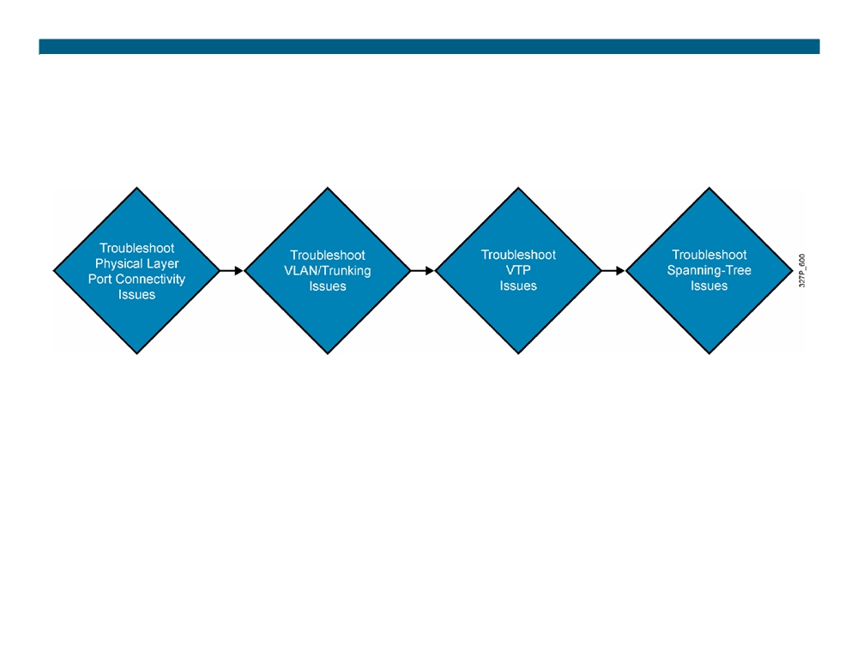
Switches Troubleshooting
General troubleshooting suggestions:
ƒ Become familiar with normal switch operation. ƒ Have an accurate physical and logical map of the network. ƒ Have a plan.
ƒ Do not assume a component is working without verifying it first.
© 2007 Cisco Systems, Inc. All rights reserved.
ICND2 v1.0—2-2
The PDF files and any printed representation for this material are the property of Cisco Systems, Inc., for the sole use by Cisco employees for personal study. The files or printed representations may not be used in commercial training, and may not be distributed for purposes other than individual self-study.

Slide 3
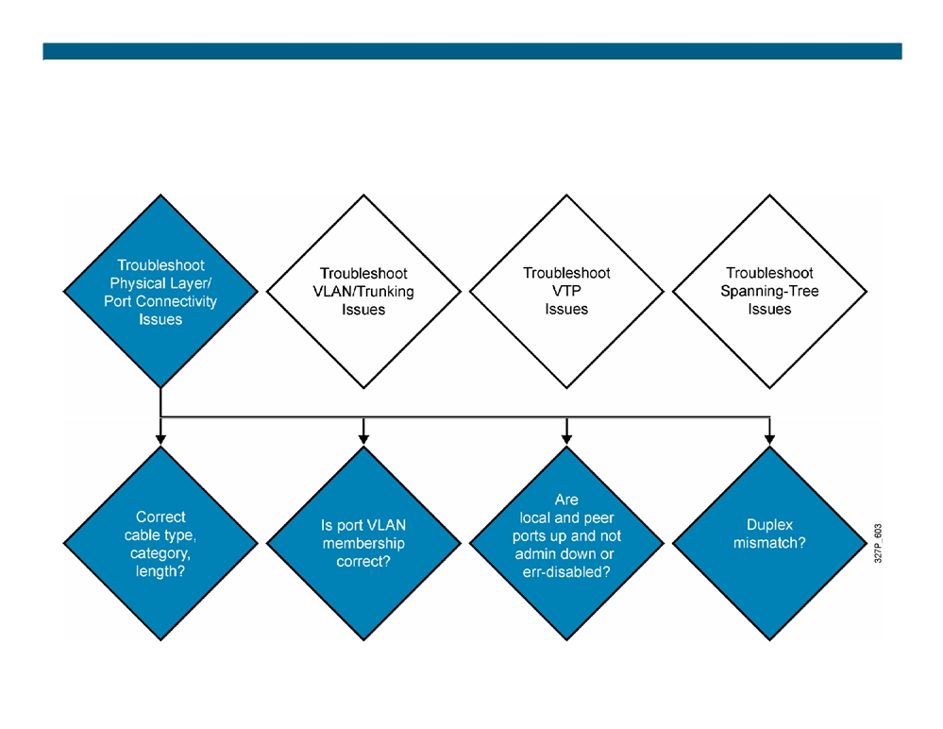
Troubleshooting Port Connectivity
© 2007 Cisco Systems, Inc. All rights reserved.
ICND2 v1.0—2-3
The PDF files and any printed representation for this material are the property of Cisco Systems, Inc., for the sole use by Cisco employees for personal study. The files or printed representations may not be used in commercial training, and may not be distributed for purposes other than individual self-study.

Slide 4
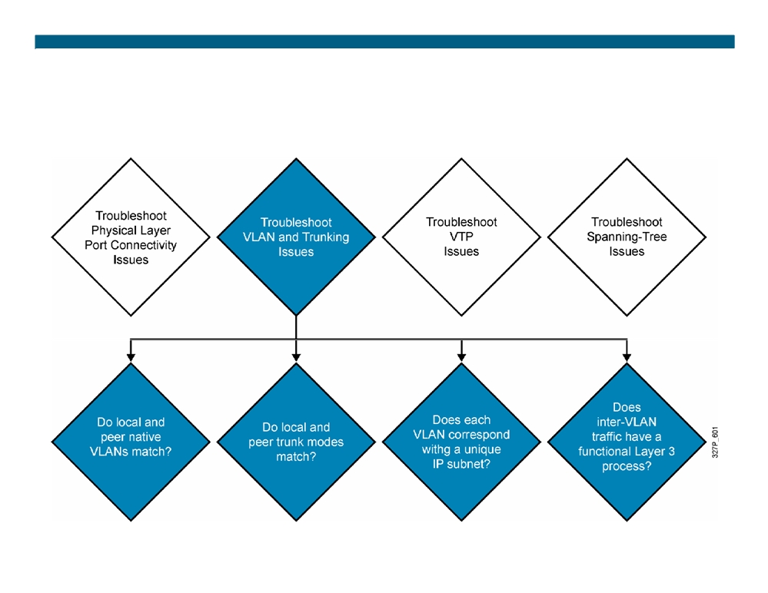
Troubleshooting VLANs and Trunks
© 2007 Cisco Systems, Inc. All rights reserved.
ICND2 v1.0—2-4
The PDF files and any printed representation for this material are the property of Cisco Systems, Inc., for the sole use by Cisco employees for personal study. The files or printed representations may not be used in commercial training, and may not be distributed for purposes other than individual self-study.

Slide 5
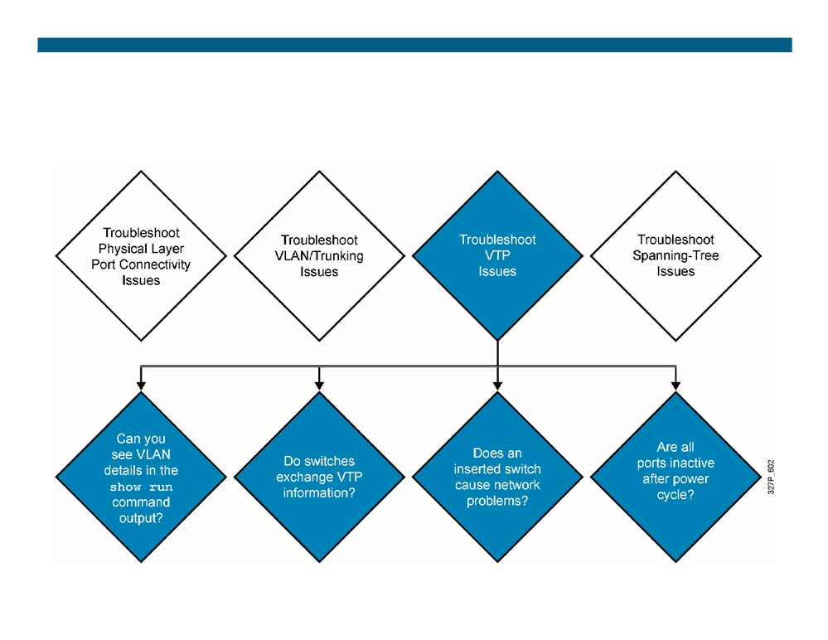
Troubleshooting VTP
© 2007 Cisco Systems, Inc. All rights reserved.
ICND2 v1.0—2-5
The PDF files and any printed representation for this material are the property of Cisco Systems, Inc., for the sole use by Cisco employees for personal study. The files or printed representations may not be used in commercial training, and may not be distributed for purposes other than individual self-study.

Slide 6

Troubleshooting VTP (Cont.)
Verify these settings if Catalyst switches do not exchange VTP information :
ƒ All ports that interconnect switches are configured as trunks. ƒ VLANs are active in all server switches.
ƒ There is at least one VTP server switch.
ƒ The VTP domain name, and password, if assigned, match on all switches (case-sensitive).
ƒ The switches all run the same version of VTP. ƒ Verify the domain name and VTP version on transparent switches.
ƒ Be aware that extended-range VLANs do not propagate for VTPv1 and VTPv2.
© 2007 Cisco Systems, Inc. All rights reserved.
ICND2 v1.0—2-6
The PDF files and any printed representation for this material are the property of Cisco Systems, Inc., for the sole use by Cisco employees for personal study. The files or printed representations may not be used in commercial training, and may not be distributed for purposes other than individual self-study.

Slide 7
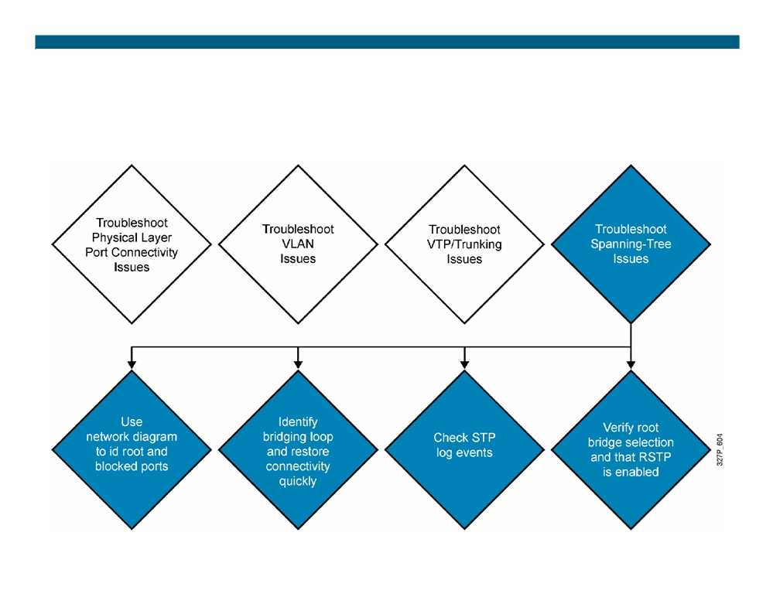
Troubleshooting Spanning Tree
© 2007 Cisco Systems, Inc. All rights reserved.
ICND2 v1.0—2-7
The PDF files and any printed representation for this material are the property of Cisco Systems, Inc., for the sole use by Cisco employees for personal study. The files or printed representations may not be used in commercial training, and may not be distributed for purposes other than individual self-study.

Slide 8
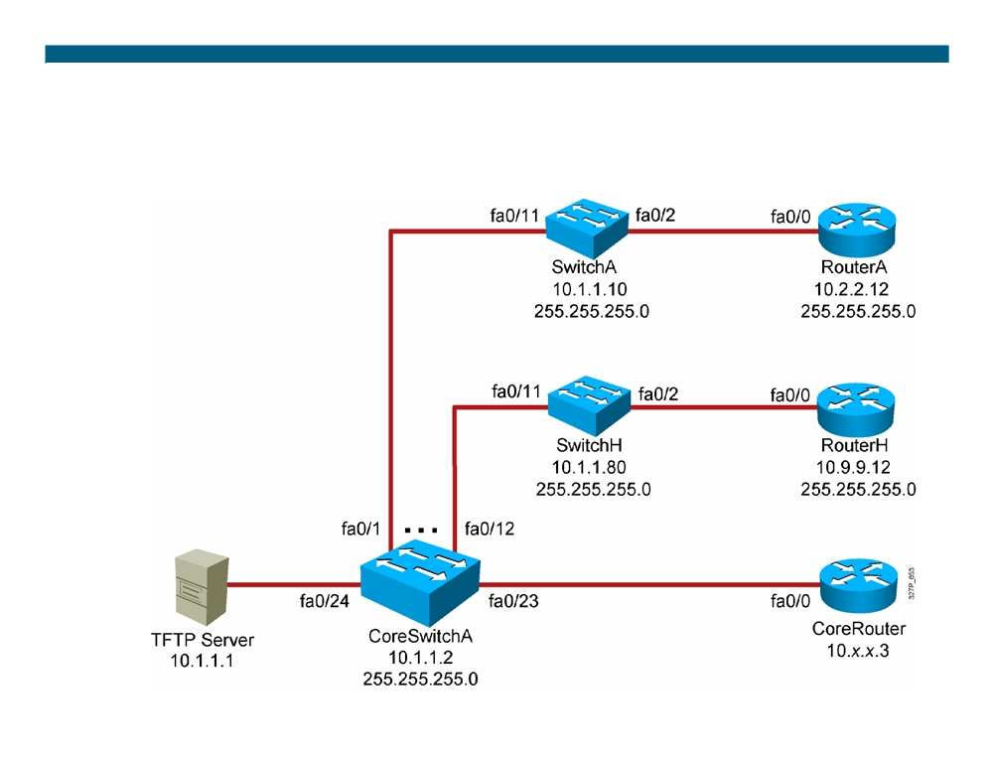
Visual Objective 2-2:
Troubleshooting Switched Networks
WG Switch
Router
fa0/0
A
10.1.1.10
10.2.2.12
B
10.1.1.20
10.3.3.12
C
10.1.1.30
10.4.4.12
D
10.1.1.40
10.5.5.12
E
10.1.1.50
10.6.6.12
F
10.1.1.60
10.7.7.12
G
10.1.1.70
10.8.8.12
H
10.1.1.80
10.9.9.12
© 2007 Cisco Systems, Inc. All rights reserved.
ICND2 v1.0—2-8
The PDF files and any printed representation for this material are the property of Cisco Systems, Inc., for the sole use by Cisco employees for personal study. The files or printed representations may not be used in commercial training, and may not be distributed for purposes other than individual self-study.

Slide 9
Summary
ƒ Effective switched-network troubleshooting begins by understanding what makes a network function correctly. ƒ Hardware issues and port configuration errors can cause port connectivity issues.
ƒ Native VLAN mismatches and trunk mode mismatches can prevent a trunk link from being established.
ƒ Understanding how VTP works is the best defense when troubleshooting VTP problems.
ƒ One of the primary objectives when dealing with an STP failure is to break the loop and restore connectivity as soon as possible.
© 2007 Cisco Systems, Inc. All rights reserved.
ICND2 v1.0—2-9
The PDF files and any printed representation for this material are the property of Cisco Systems, Inc., for the sole use by Cisco employees for personal study. The files or printed representations may not be used in commercial training, and may not be distributed for purposes other than individual self-study.

Slide 10

© 2007 Cisco Systems, Inc. All rights reserved.
ICND2 v1.0—2-2 The PDF files and any printed representation for this material are the property of Cisco Systems, Inc., for the sole use by Cisco employees for personal study. The files or printed representations may not be used in commercial training, and may not be distributed for purposes other than individual self-study.

